Slide 1
EECT 121 Lab Notebook
Lucas Bazile

Slide 2
Lab 1
Objectives
Simulate band-pass filter

Slide 3
Simulation

Slide 4
Lab 2
Objectives
Simulate half-wave, full-wave, and wheatstone bridge full wave rectifiers.
Build, test, and record results of rectifiers.

Slide 5
Schematics
Half Wave Rectifier
Wheatstone Bridge Rectifier
Full Wave Rectifier

Slide 6
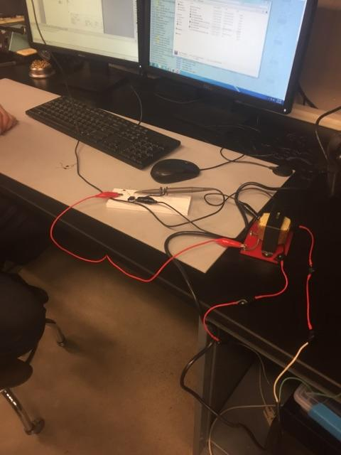
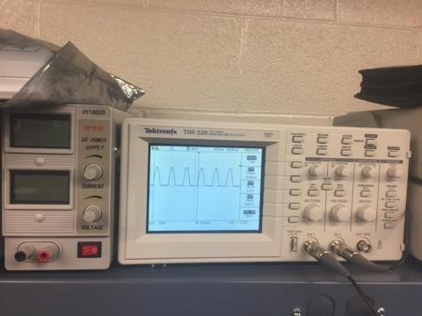
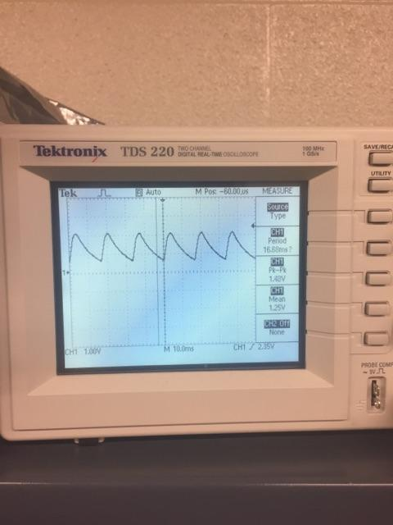
Half Wave Rectifier
Half Wave Rectifier circuit
Half Wave Rectifier with Filter
Half Wave Rectifier readings

Slide 7
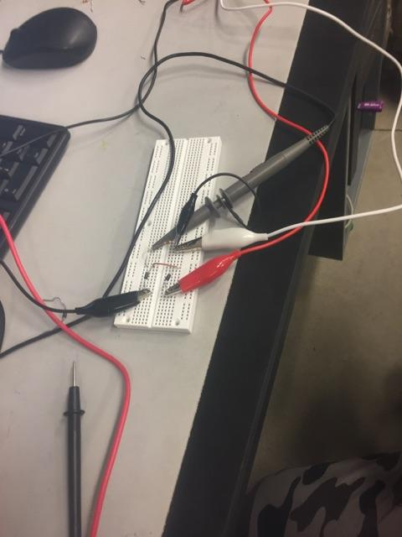
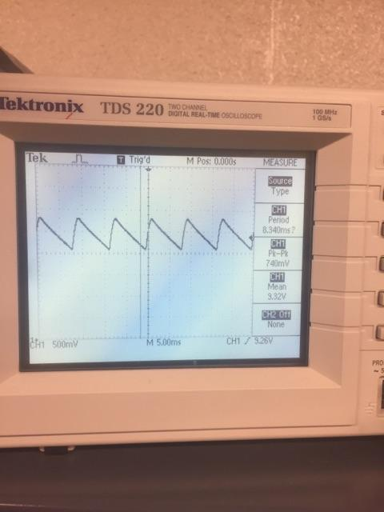
Full Wave Rectifier
Oscilloscope readings with filter
Full Wave Rectifier Circuit

Slide 8
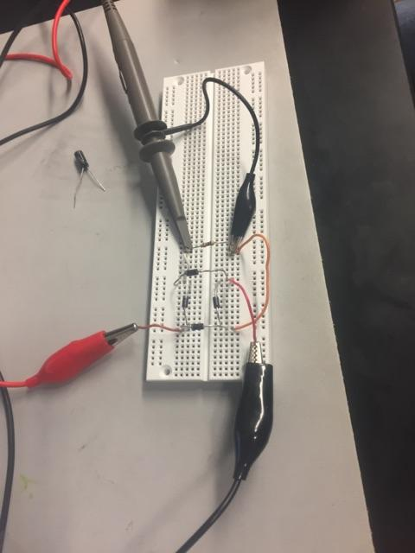
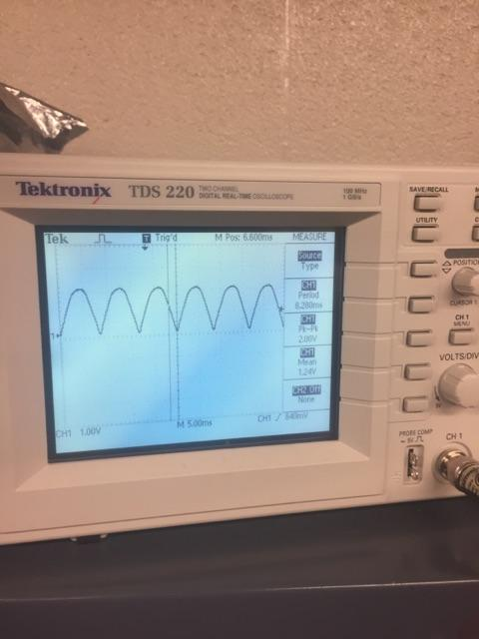
Wheatstone Bridge Rectifier
Wheatstone Bridge Rectifier Circuit
Oscilloscope readings

Slide 9
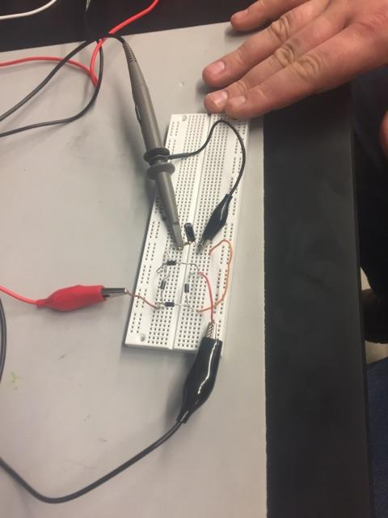
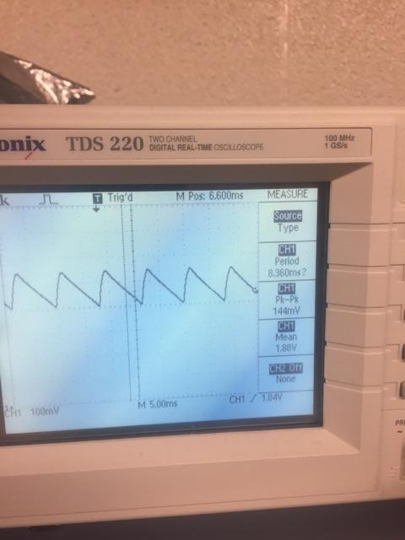
Wheatstone Bridge circuit with filter
Oscilloscope readings with filter

Slide 10
Notes
I had trouble with building the wheatstone bridge simulation initially but was able to get it working.
I didn’t realize that filters were put in parallel with the rectifiers themselves so that was cool to see.
All of our oscilloscope readings came out exactly how we would have expected them to so there was no confusion with this lab.

Slide 11
Lab 3
Objectives
Simulate and build a 9v positive dc power supply using wheatstone bridge rectifier and LM317 regulator

Slide 12
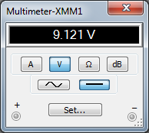
Simulation

Slide 13
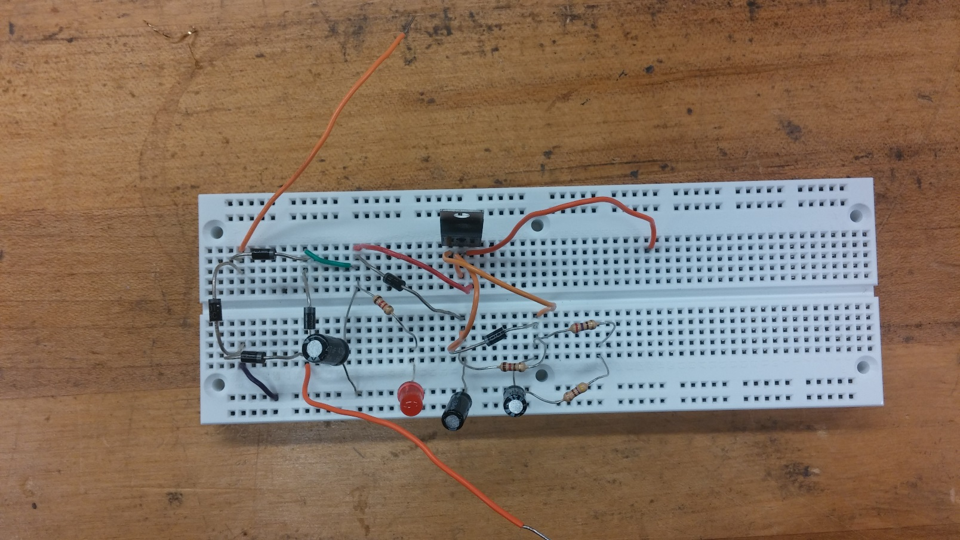
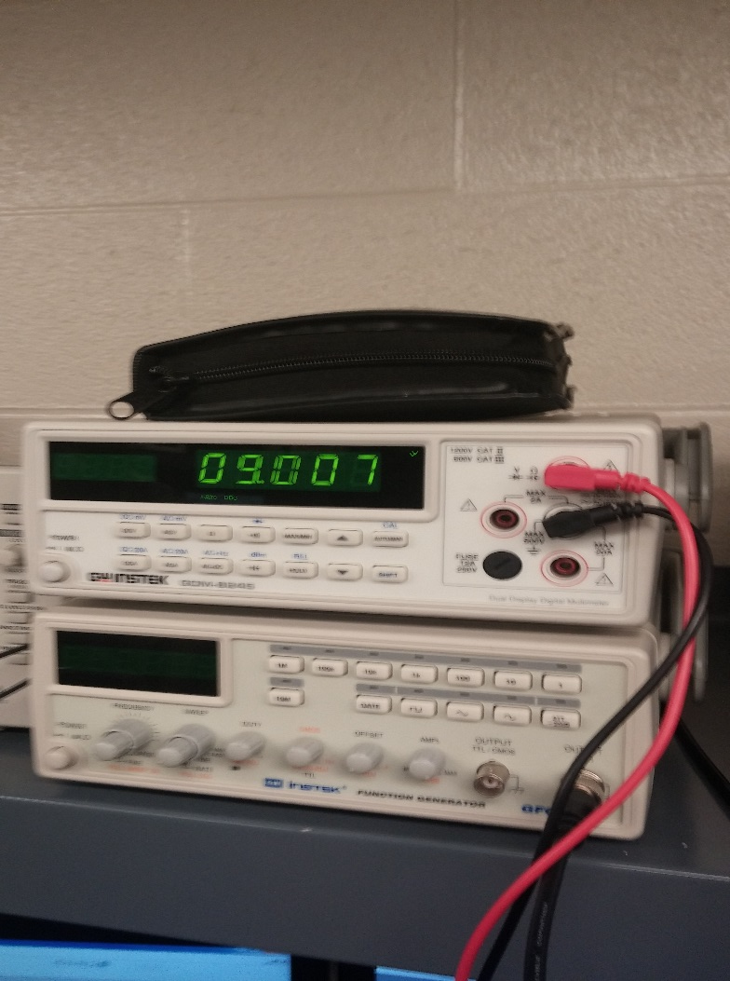
Build Pictures

Slide 14
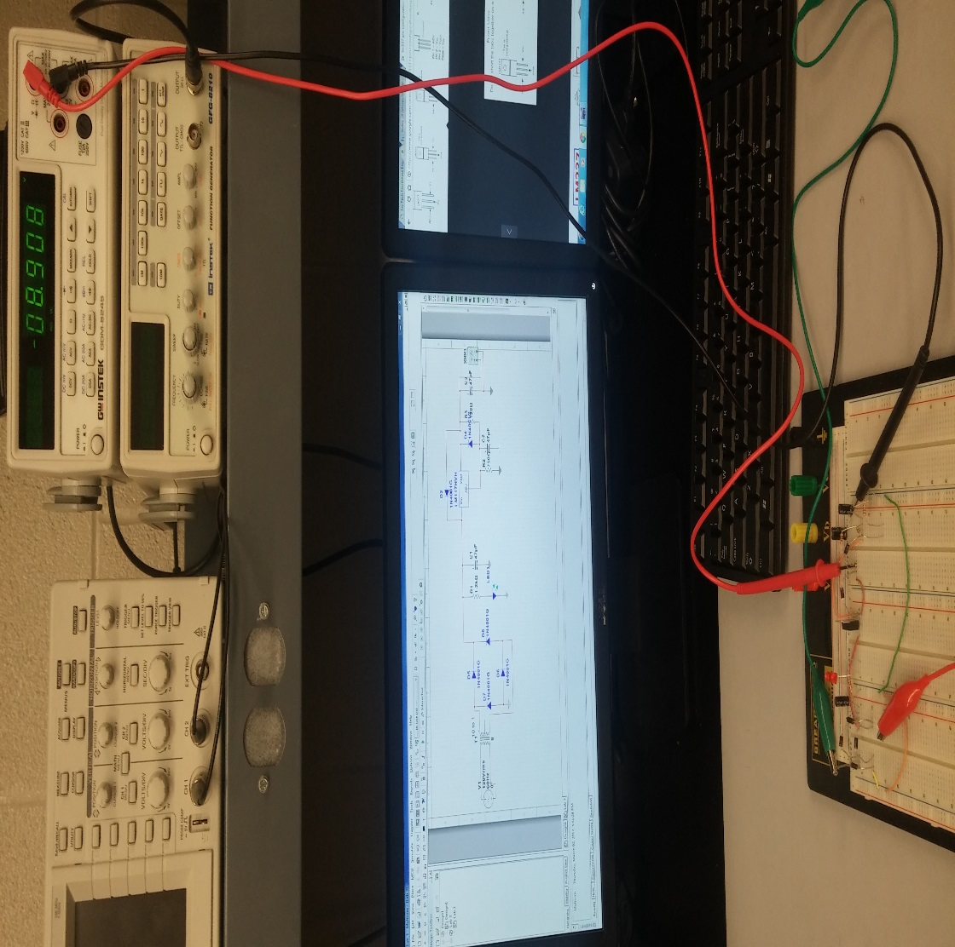
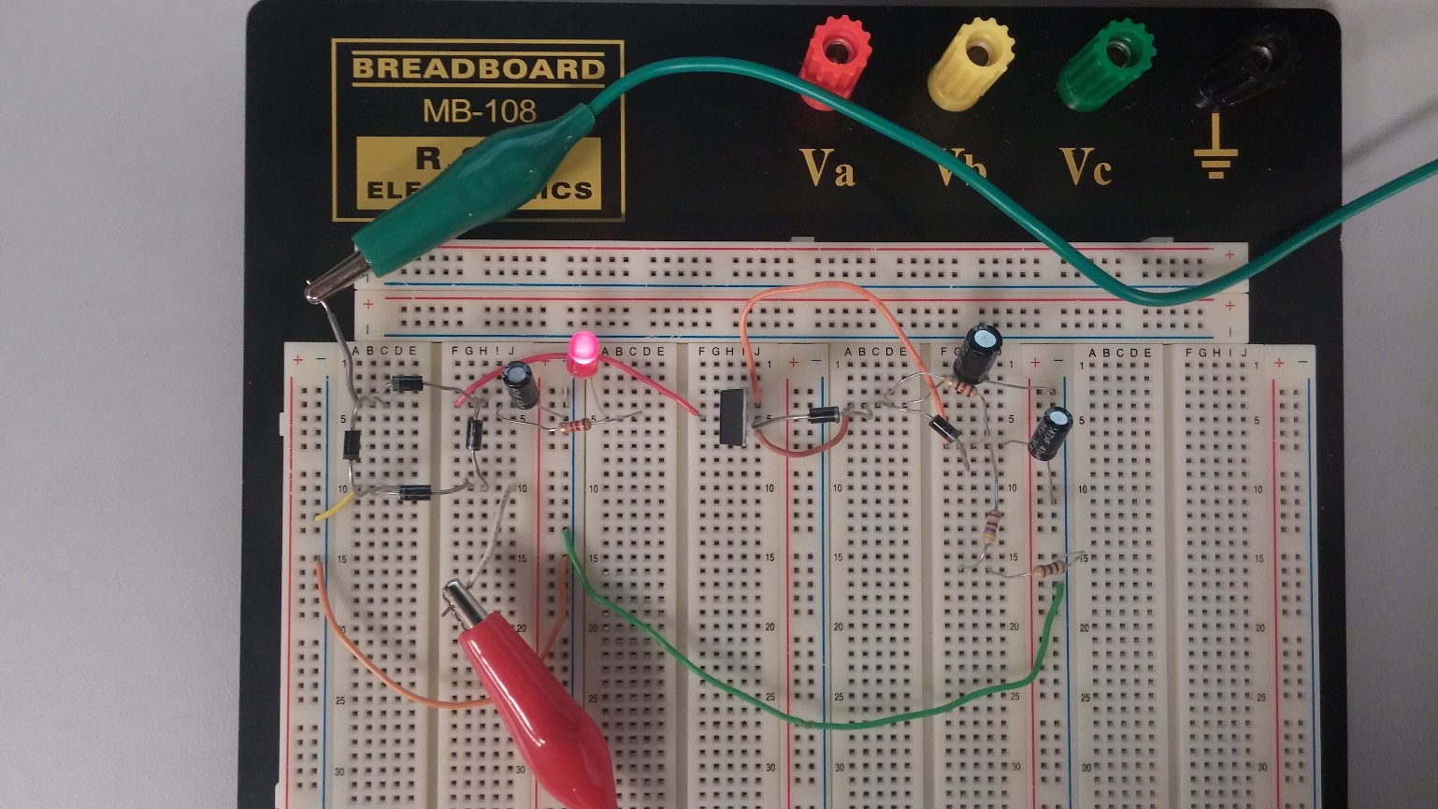
Build

Slide 15
Notes
We weren’t able to simulate the negative rectifier because multisim doesn’t have the lm337.
My readings were pretty good at 9.007v and -8.908v

Slide 16
Lab 4
Objectives
Simulate and build a 9v negative dc power supply using wheatstone bridge rectifier and LM337 regulator

Slide 17
Simulation

Slide 18
Notes
Multisim didn’t have the negative regulator so we had to follow the procedure to build a custom part in mulstisim.

Slide 19
Lab 5
Objectives
Build the + and – 9v power supply

Slide 20
Simulation

Slide 21
Lab 6
Objectives
Simulate and build transistor in dc circuit

Slide 22
Simulation

Slide 23
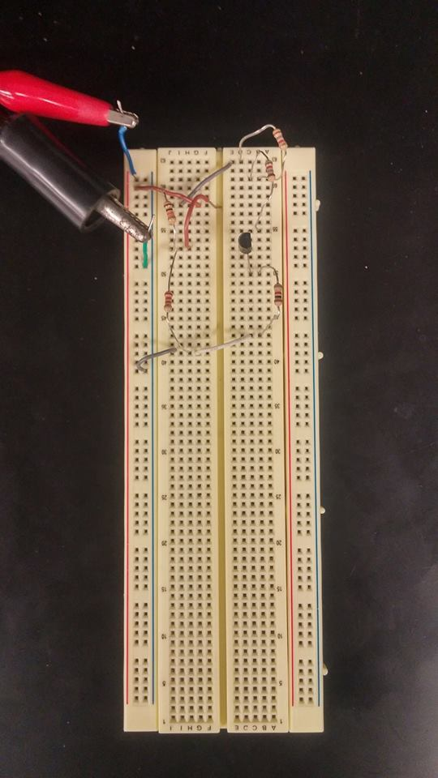
Build

Slide 24
Notes
Transistor can be used as a switch in a DC circuit.

Slide 25
Lab 7
Objectives
Simulate and build circuit using transistor in AC circuit.

Slide 26
Simulation

Slide 27
Notes
Took a little while to get used to AC analysis but It makes sense now.
I wish there was time to work on a class AB transistor circuit

Slide 28
Lab 8
Simulate and build inverting and non-inverting op-amps

Slide 29
Simulation
Non-inverting amplifiers

Slide 30
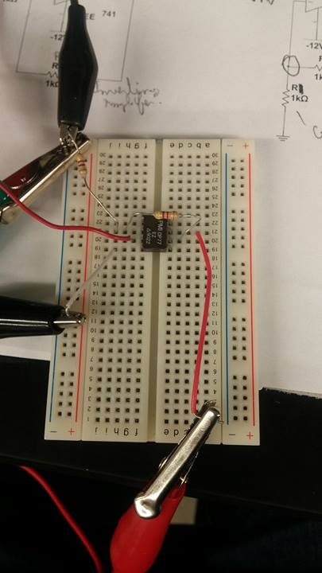
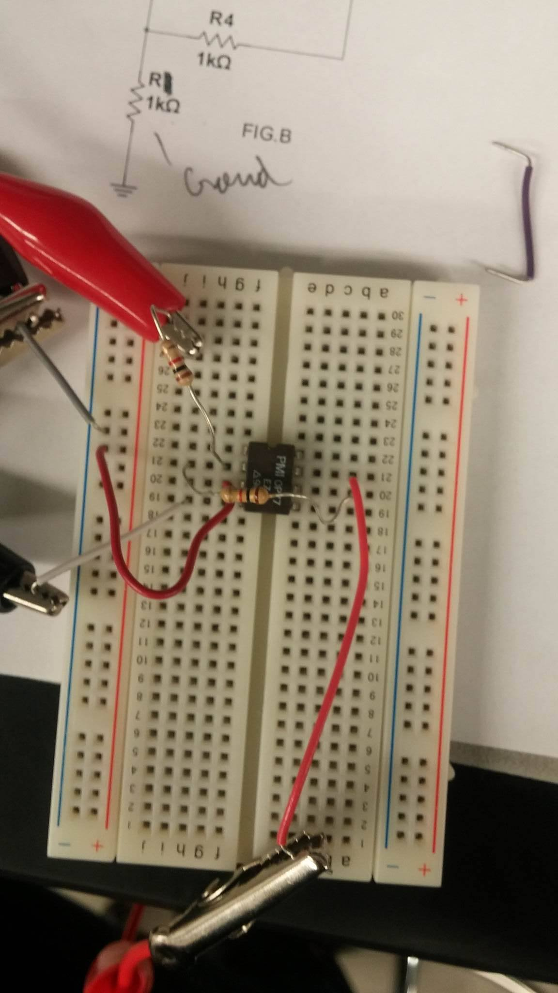

Slide 31
Notes
We didn’t have the same components that we used in multisim so we had to experiment until we found some with the same properties.

Slide 32
Lab 9
Objectives
Simulate and build difference amplifier circuit.

Slide 33
Simulation

Slide 34
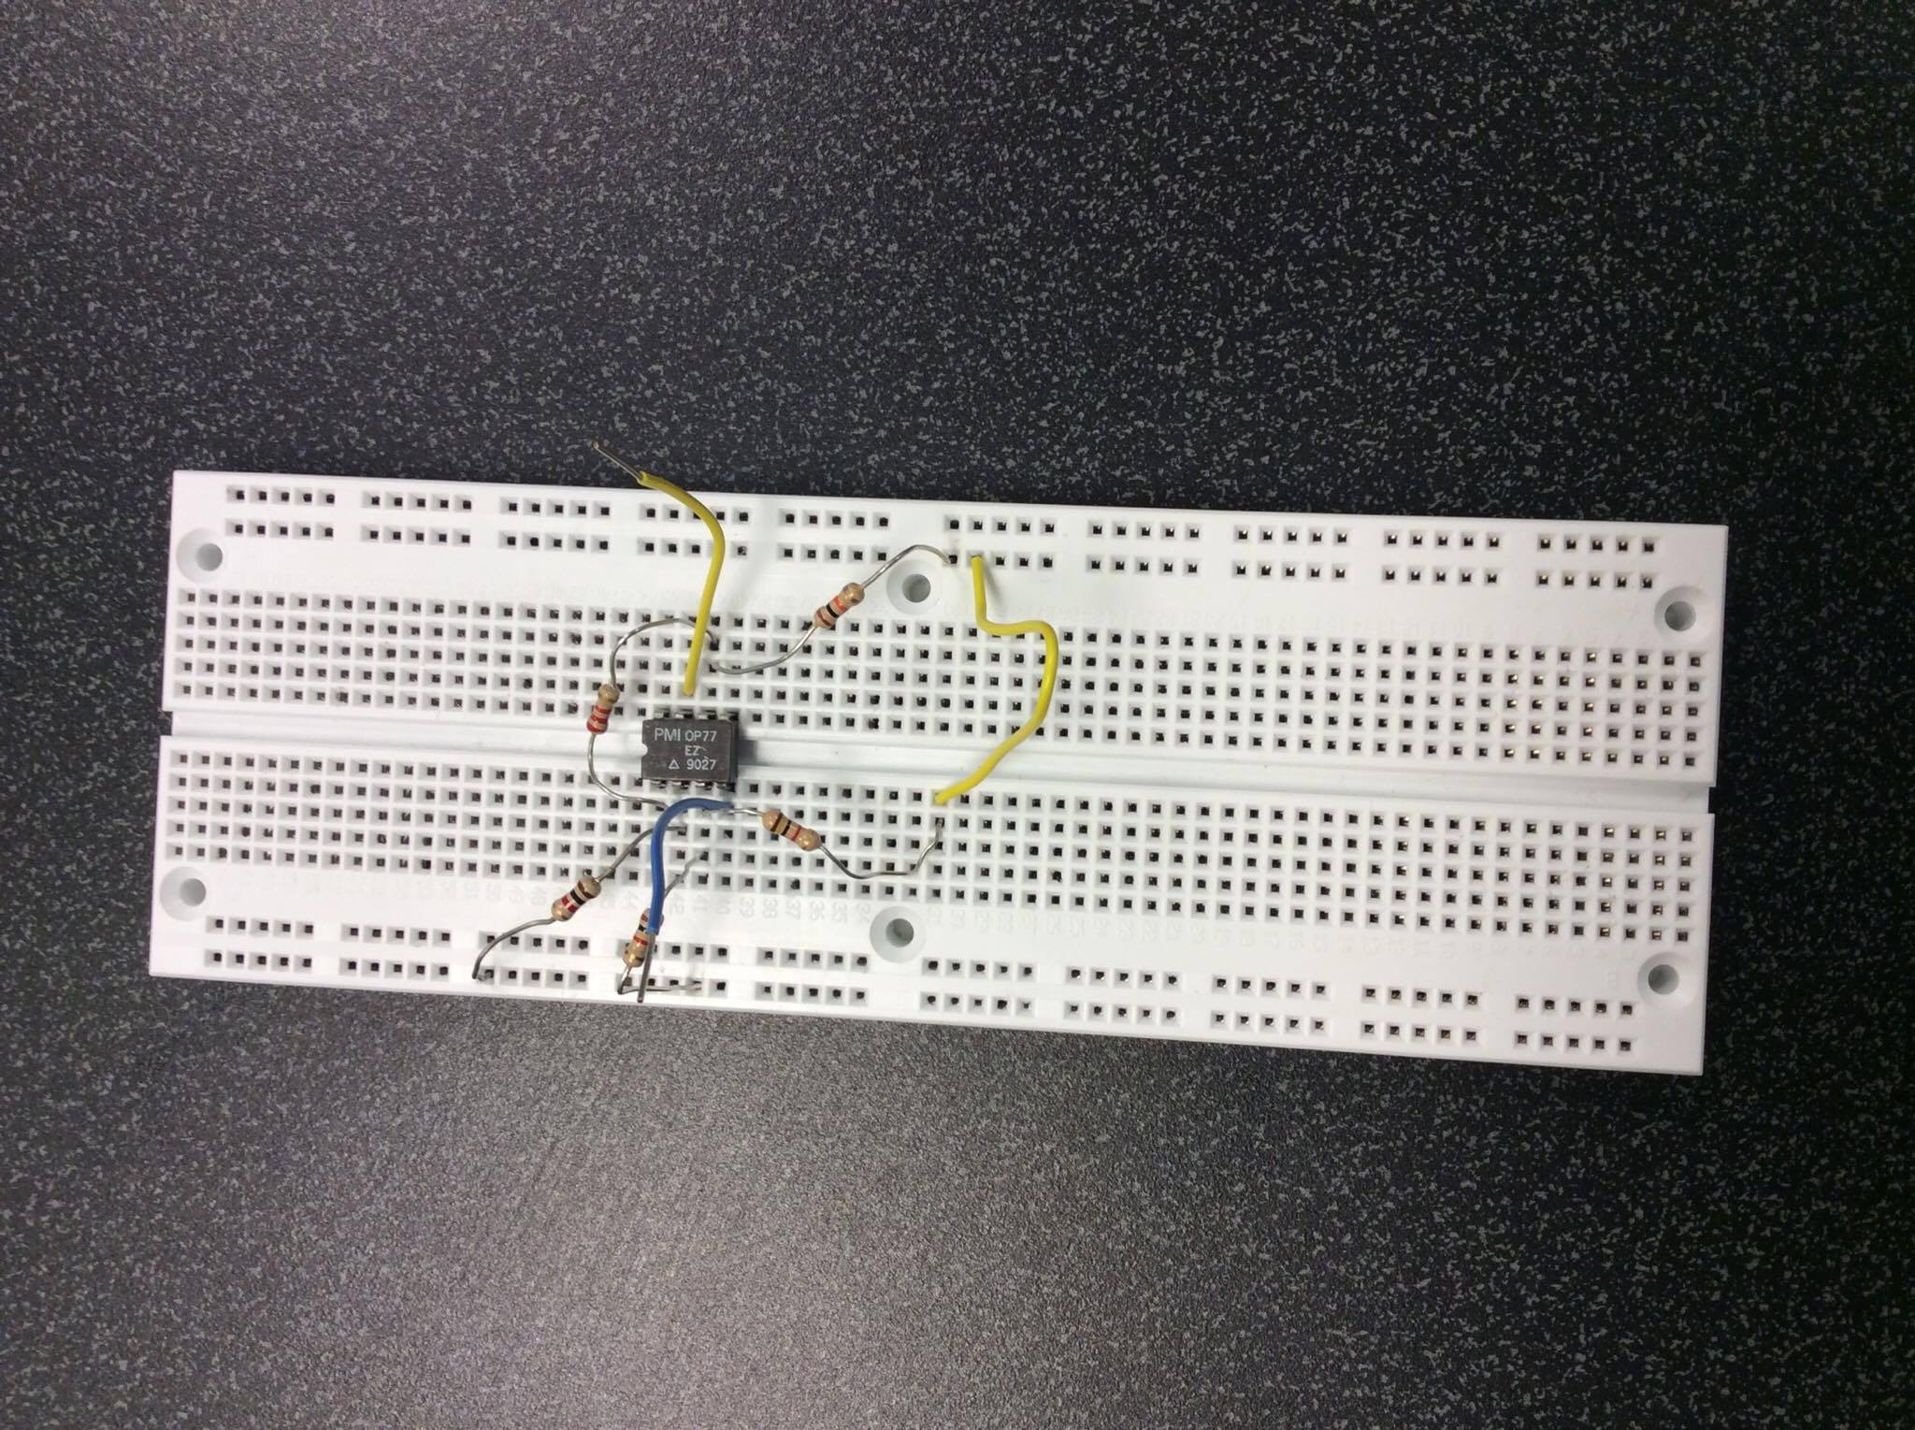

Slide 35
Notes
The difference amplifier output is the algebraic sum of the two inputs.

